Slide 1


INTRODUCTION TO HTML
WHAT IS HTML??
HTML stands for Hyper Text Markup Language, which is the most widely used language on Web to develop web pages
HTML is the language for describing the structure of Web pages.
Using HTML, you can create a Web page with text, graphics, sound, and video.
HTML provides a means to create structured documents by denoting structural semantics for text such as headings, paragraphs, lists, links, quotes and other items.

Slide 2
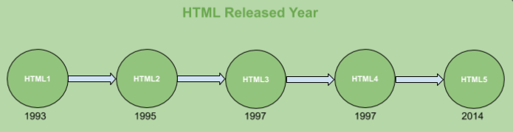
The first version of HTML was written by Tim Berners-Lee in 1993. Since then, there have been many different versions of HTML.
There are 4 Versions of HTML
HTML 1.0 (1989 - 1994)
HTML 2.0 (1995)
HTML 3.20 (1997)
HTML 4.01 (1999)
Current version: HTML 5.0

Slide 3

HTML TAGS
HTML tags are like keywords which defines that how web browser will format and display the content. With the help of tags, a web browser can distinguish between an HTML content and a simple content. HTML tags contain three main parts: opening tag, content and closing tag.
All HTML tags must enclosed within < > these brackets.
Every tag in HTML perform different tasks.
If you have used an open tag <tag>, then you must use a close tag </tag> (except some tags)

Slide 4
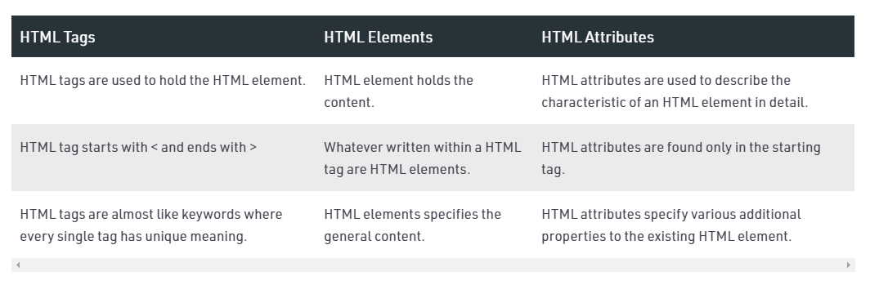

Slide 5
HTML STRUCUTRE
An HTML Document is mainly divided into two parts:
Head
The <head> element of an HTML document is the part that is not displayed in the web browser when the page is loaded.
It consists of attributes such as Title, Links ,Scripts etc.
Body
HTML <body> tag defines the main content of an HTML document which displays on the browser.
It can contain text content, paragraphs, headings, images, tables, links, videos, etc.
The <body> must be the second element after the <head> tag or it should be placed between </head> and </html> tags. This tag is required for every HTML document and should only use once in the whole HTML document.

Slide 6
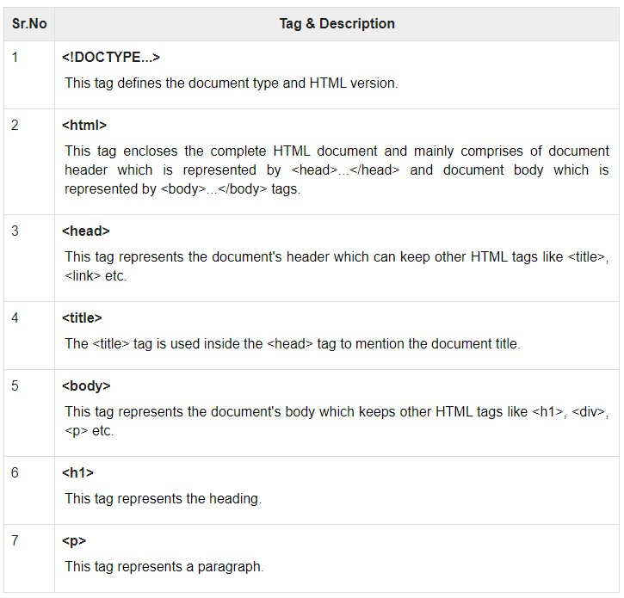

Slide 7
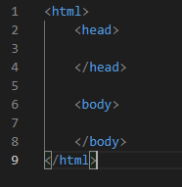
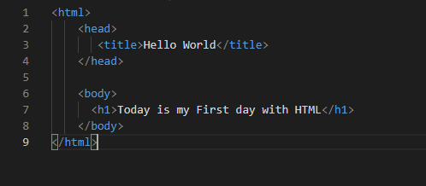
BASIC STRUCUTRE
BASIC CODE

Slide 8
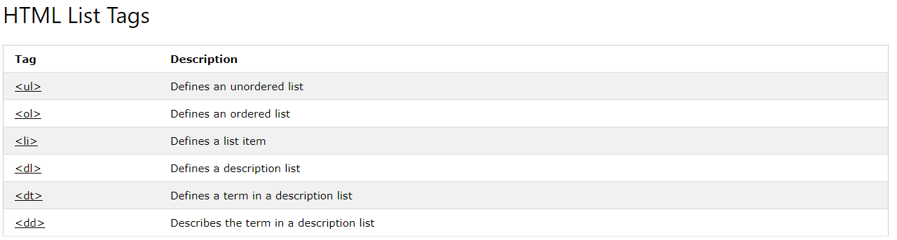

Slide 9
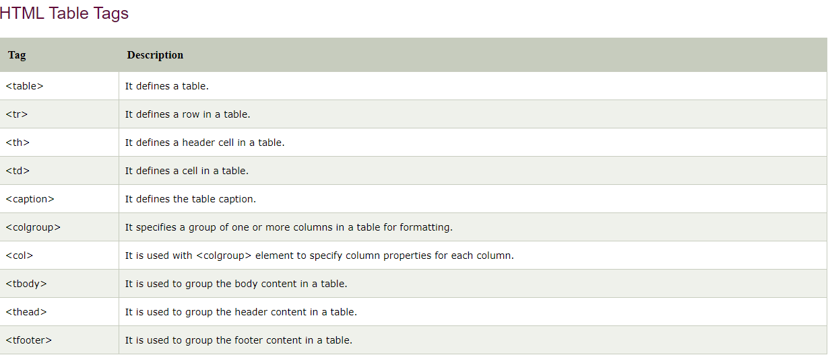

Slide 10
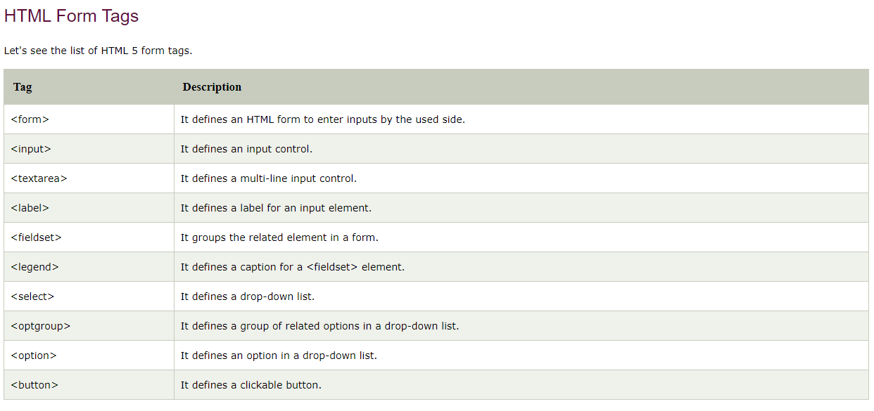

Slide 11
COLORS
HTML colors are specified with predefined color names, or with RGB, HEX, HSL, RGBA, or HSLA values.
HTML supports 140 STANDARD color names
Such as-
Tomato
Orange
DodgerBlue
MediumSeaGreen
Gray
SlateBlue
Violet
LightGray

Slide 12
RGB Colors
In HTML, a color can be specified as an RGB value, using this formula:
rgb(red, green, blue)
Each parameter (red, green, and blue) defines the intensity of the color with a value between 0 and 255.
This means that there are 256 x 256 x 256 = 16777216 possible colors!
For example, rgb(255, 0, 0) is displayed as red, because red is set to its highest value (255), and the other two (green and blue) are set to 0.
Another example, rgb(0, 255, 0) is displayed as green, because green is set to its highest value (255), and the other two (red and blue) are set to 0.
To display black, set all color parameters to 0, like this: rgb(0, 0, 0).
To display white, set all color parameters to 255, like this: rgb(255, 255, 255).

Slide 13
HEX Colors
In HTML, a color can be specified using a hexadecimal value in the form:
#rrggbb
Where rr (red), gg (green) and bb (blue) are hexadecimal values between 00 and ff (same as decimal 0-255).
For example, #ff0000 is displayed as red, because red is set to its highest value (ff), and the other two (green and blue) are set to 00.
Another example, #00ff00 is displayed as green, because green is set to its highest value (ff), and the other two (red and blue) are set to 00.
To display black, set all color parameters to 00, like this: #000000.
To display white, set all color parameters to ff, like this: #ffffff.

Slide 14
HSL Colors
In HTML, a color can be specified using hue, saturation, and lightness (HSL) in the form:
hsl(hue, saturation, lightness)
Hue is a degree on the color wheel from 0 to 360. 0 is red, 120 is green, and 240 is blue.
Saturation is a percentage value, 0% means a shade of gray, and 100% is the full color.
Lightness is also a percentage value, 0% is black, and 100% is white.

Slide 15
LIST
THERE ARE THREE TYPES OF LIST
UNORDERED LIST
ORDERED LIST
DIFINITON LIST

Slide 16
Ordered List
It starts with <ol> tag and ends with </ol> tag
<li> tag is an integral part of list Tag
This list marks list items with Numbers
There are two major attribute availabe

Slide 17
Unordered List
It starts with <ul> tag and ends with </ul> tag
<li> tag is an integral part of list Tag
This list marks list items with bullet
There is one major attribute availabe

Slide 18
Definition List
It starts with <dl> tag and ends with </dl> tag
<dt> and <dl> are integral part of this List
There are no major attributes available for this list

Slide 19
Nested List
We can use multiple types of list in an single html file and that is called as Nesting of List

Slide 20
TABLES
The HTML tables allow web authors to arrange data like text, images, links, other tables, etc. into rows and columns of cells
The HTML tables are created using the <table> tag in which the <tr> tag is used to create table rows and <td> tag is used to create data cells.
The elements under <td> are regular and left aligned by default
There are few attributes available for table such as Colspan,Rowspan,Cellspacing,Cellpadding etc etc.

